Slide 1
Flow(1)
Publisher/ Subscriber Event Flow
Subscriber/Application makes the call to the Publisher. Once the request is made, it creates an event with the server and the request thread will be released to handle other requests. This invokes the subscribe() method of the Publisher.
Publisher responds to subscriber by returning a Subscription Object. During this time the onSubscribe() of the Subscriber is invoked which receives the Subscription Object
Using the Subscription object returned by the Publisher, The subscriber requests the bounded/unbounded number of elements using the request() method of the Subscription
Publisher publishes the events/messages/elements to the Subscriber by invoking the onNext() method of the Subscriber
Once all the elements are published then only the Publisher then only the onComplete() method of the Subscriber is invoked. In case of any error before completion onError() is invoked
Subscriber
subscribe()
Publisher
onSubscribe()
onNext()
onNext()
onNext()
onNext()
onNext()
onComplete()
onError()
Subscription
request(3)
request(2)
Source: https://dzone.com/articles/build-reactive-rest-apis-with-spring-webflux
Notes:
Publisher can be any of the data source: file/Message Queue/Database

Slide 2
Flow(2)
Back Pressure
Requirement and Need of Back Pressure: Assume there is a client application/subscriber that is requesting data from another service/publisher.
The service/publisher is able to publish the events at the rate of 1000TPS but the client application/subscriber is able to process the events at the rate of 200TPS.
In this case, the client application should buffer the rest of the data to process. Over the subsequent calls, the client application may buffer more data and eventually run out of memory.
This causes the cascading effect on the other applications which depends on the client application.
Subscriber
subscribe()
Publisher
onSubscribe()
onNext()
onNext()
onNext()
onNext()
onNext()
Solution: To avoid this the client application can ask the publisher to buffer the events at their end and push the events at the rate of the client application. This is called backpressure.
onError()
/onComplete()
Back Pressure
Source: https://dzone.com/articles/build-reactive-rest-apis-with-spring-webflux
Notes:
Publisher can be any of the data source: file/Message Queue/Database

Slide 3
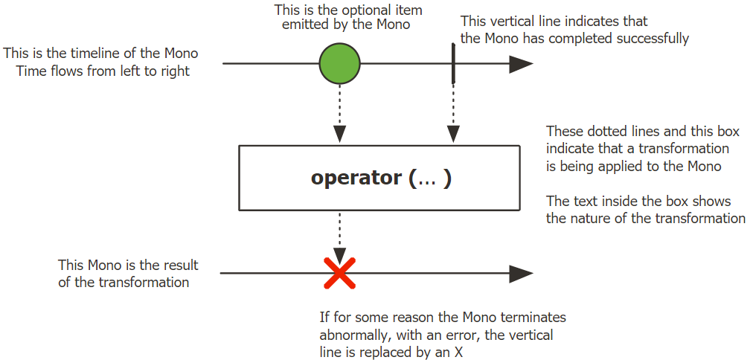
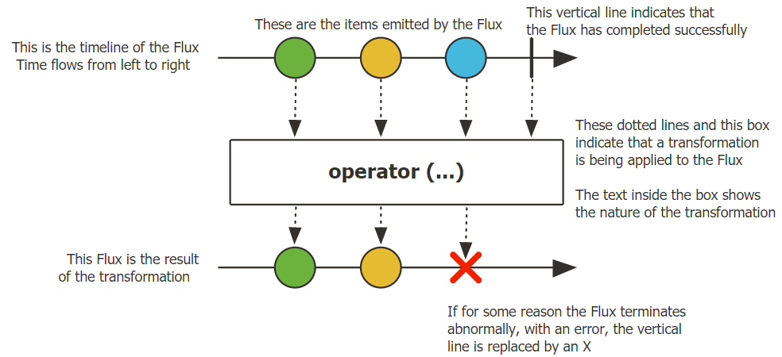
Mono and FLUX
Introduction
Project Reactor is implementation of the Reactive Streams in Java. It is divided into: reactor-core, reactor-test, reactor-netty
reactor-core gives 2 types of Publishers :Mono [0,1], Flux [0…n]. reactor-test gives StepVerifier and TestPublisher. In current course, StepVerifier is used to verify the values/events emitted by the publishers
Mono is Publisher that can publish 0 or 1 value/events, where as Flux can publish 0 or n values/events
Mono and Flux and operations on them can be interpreted using Marble Diagrams. Refer the Marble Diagrams for Mono and Flux given below:
Mono
Flux
Source: https://projectreactor.io/docs/core/release/api/reactor/core/publisher/Mono.html
https://projectreactor.io/docs/core/release/api/reactor/core/publisher/Flux.html

